Slide 1
Automatic Scoring-up of Mensural Parts
Martha E. Thomae, Julie E. Cumming, Ichiro Fujinaga
Centre for Interdisciplinary Research in Music Media and Technology (CIRMMT)
McGill University
Notes:
[Next Slide Beg:] THIS TOOL IS MEANT TO WORK WITH MENSURAL MUSIC. Mensural music refers to vocal polyphonic music written between the 1250s and the 1600s, which used an older system of music notation called “mensural notation”
HERE WE HAVE an example of a mensural piece [Click!]

Slide 2
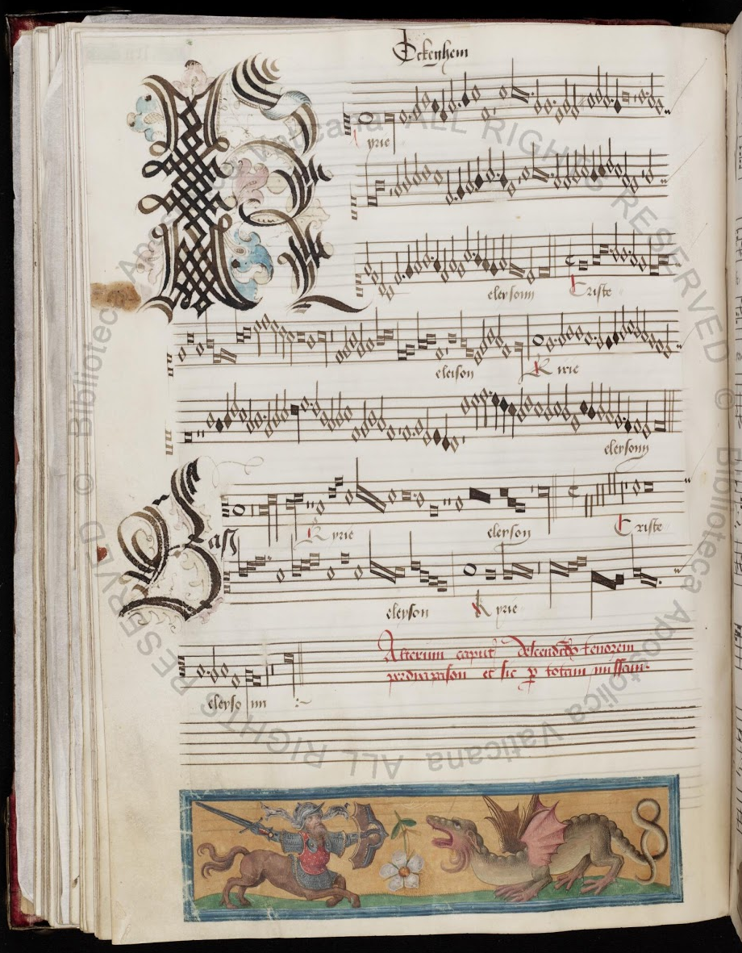
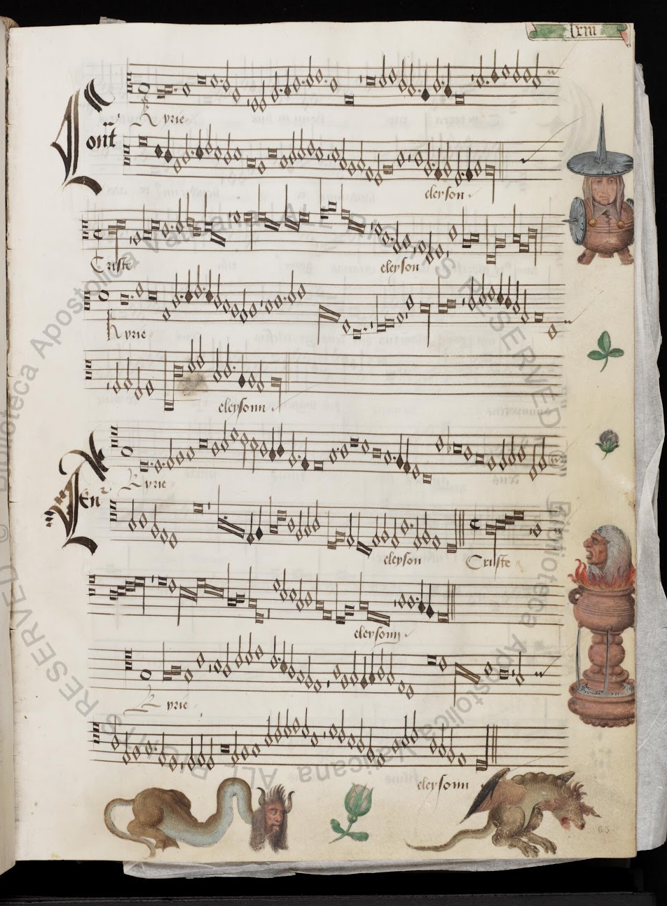
Notes:
Most mensural music was written in separate parts rather than in score format.
It present the voices separately, in different areas of the page.
You can see that in this example. …
This separate arrangement of the voices makes it harder to analyze this music:
While you have all the melodic information of each voice
You cannot visualize the vertical sonorities that easily, because the notes are not lined-up (as will be the case if the voices were presented in score format)
- - - - -

Slide 3
Motivation
The purpose of this project is to take all the notes from each of the mensural parts (i.e., voices) and line them up automatically, in order to present the piece in score format, a process that we refer to as “scoring up”
To facilitate counterpoint studies (this is, the study of the relation between the voices)
Notes:
[Aft. 1] So we are developing an automatic scoring-up tool
[Aft. 2] for which we need to visualize the vertical sonorities.
So, even though the TASK of the "scoring-up tool" SEEMS PRETTY SIMPLE (just lining-up the notes of the different voices), it is COMPLICATED BY THE NATURE OF THE NOTATION ITSELF.
So lets talk about mensural notation...

Slide 4
Notes:
Mensural notation is the immediate predecessor of our Common Western Music Notation system, and when IT started, we already had an EXPLICIT way to notate PITCH:
Staff-lines
Clefs
But the same did not applied to rhythm yet.
We already had different note-shapes as you can see here, but they did not EXPLICITLY conveyed the duration of the note.
It is common to have the same note shape being used twice, even next to each other, and representing different durations…
This complicates the scoring-up task, because in order to line the notes up we need to know their duration.

Slide 5
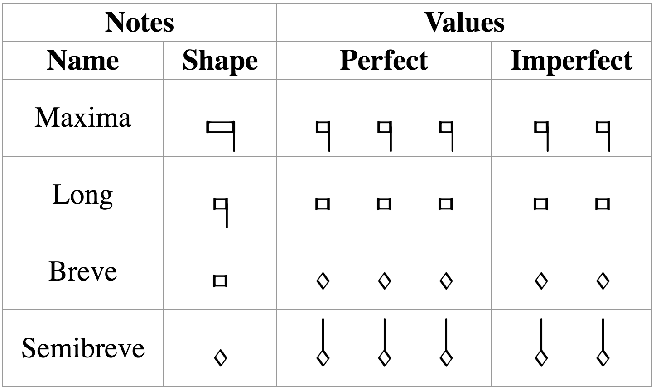
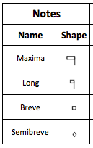
Mensural Notation
There is a clear hierarchy in the note duration
longest
shortest
Mensuration
Establishes the relation between the note values (“perfect” or “imperfect”)
Notes:
Like I said, we already have different note shapes and there is a clear hierarchy regarding the note duration
But, each note shape can have two different values, it can be ternary or binary.
The ternary value is called perfect, because …, and the binary value is then called imperfect
We have this REALLY IMPORTANT concept in mensural notation: MENSURATION
So what about …? In imperfect mensuration → note-shape explicitly indicates binary value
You want to change that → to use some external (graphical) cues
JUST LIKE IN CMN: All the notes are binary, if you want to change that you use a dot or a triplet sign
--> In Mensural: binary, and to change that you use a dot called dot of augmentation which behaves the same as a Common Dotted Note.
Scoring up mensural music in imperfect mensuration would be the same as scoring up common western music
So, what is the problem?
The challenge occurs when dealing with PERFECT MENSURATION at ANY OF THESE FOUR NOTE-LEVELS (it could be in the four at once). [CHANGE SLIDE]

Slide 6
In perfect mensurations, the duration of the individual note symbols is not absolute, but rather depends on context
Notes:
The MENSURATION gives us a semifixed relation between the duration of the notes, but that relation can be changed by the context (I.E., THE NOTES AROUND)
AND IT IS THIS CONTEXT-DEPENDENCY ISSUE THAT IS THE MAIN FOCUS OF THE SCORING-UP TOOL
There are certain principles on how context affects the note value. I am not going to enumerate all of these principles, but I will give an example of the general idea of on how these principles work.

Slide 7




Examples of Context Changing the Note’s Value
Mensuration: Breve = 3 → Breves are perfect by default
Principles of
Imperfection
and Alteration
Imperfection
Perfect → Imperfect
Alteration
x 2
Notes:
1. This breve is perfect, this breve is perfect, and so on…
2. That is the idea in perfect mensuration, we have this triple meter, WE MOVE IN A SERIES OF PERFECTIONS
3. Outlined by Franco of Cologne (ca. 1280)
4. Tells us when to imperfect or alter a note based on the number of notes between the boundaries of these kinds of sequences (so, sequences that are bounded by notes that are supposed to be perfect, according to the mensuration).
5. So the scoring-up DEALS with the CONTEXT-DEPENDENT nature of mensural notation by IMPLEMENTING these PRINCIPLES of IMP and ALT

Slide 8
Algorithm
Mensuration: Breve = 3 → Breves are perfect by default
Notes:
Lets walk through the algorithm that implements these principles
By using an example
Lets say we have the mensuration… which indicates that by default …
Steps:
1. Divide the notes into sequences of the form we saw in the previous slide.
Find all the breves
Find all the sequences that are bounded by those breves…
2. For each of those sequences we get the number of semibreves, since that will indicate the modification that we have to perform.
So lets take one of such sequences as an example

Slide 9
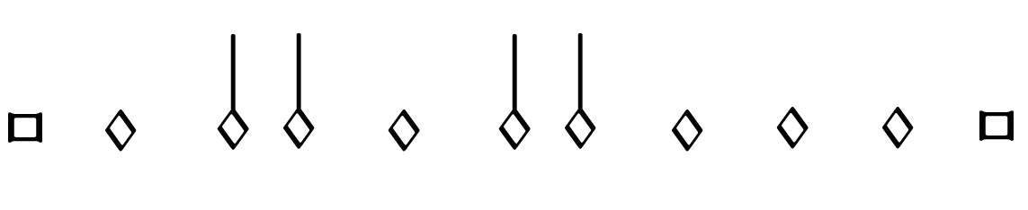
Example: (sequence bounded by breves)
1
2
3
4
5
6
7
7 semibreves = Two groups of 3 semibreves + 1
Notes:
So lets take one of such sequences as an example
So here we have 7 semibreves
And what we do is that we group those 7 semibreves into perfect groups (groups of 3 semibreves) and see HOW MANY ARE LEFT OUT

Slide 10
Number N of semibreves between the boundaries | Number P of perfect groups of semibreves | General Interpretation | Alternative Interpretation
N = 3P + 1 | P >= 0 | Imperfection a.p.p. | Imperfection a.p.a.
N = 3P + 2 | P = 0 | Alteration | Imperfection a.p.p. & Imperfection a.p.a.
 | P > 0 | Imperfection a.p.p. & Imperfection a.p.a. | Alteration
N = 3P | P = 0 | - | -
 | P = 1 |  | Imperfection a.p.p. & Alteration
 | P > 1 | Imperfection a.p.p. & Alteration | -
Notes:
Use a DOT OF DIVISION between … to indicate that they belong to different perfections

Slide 11
Number N of semibreves between the boundaries | Number P of perfect groups of semibreves | General Interpretation | Alternative Interpretation
N = 3P + 1 | P >= 0 | Imperfection a.p.p. | Imperfection a.p.a.
N = 3P + 2 | P = 0 | Alteration | Imperfection a.p.p. & Imperfection a.p.a.
 | P > 0 | Imperfection a.p.p. & Imperfection a.p.a. | Alteration
N = 3P | P = 0 | - | -
 | P = 1 |  | Imperfection a.p.p. & Alteration
 | P > 1 | Imperfection a.p.p. & Alteration | -
Notes:
Use a DOT OF DIVISION between … to indicate that they belong to different perfections
➔ So the grouping now would be

Slide 12
Scoring-up tool
Deals with the context-dependent nature of mensural notation
By implementing the “principles of imperfection and alteration”
Deals with other non-context related features:
Dots of Augmentation
Coloration
When?
Distinguish between “dots of division” and “dots of augmentation”
When does coloration affect the note value?
Notes:
[START Content of the Slide]
[In Non-Context Related Features]
Dots of augmentation are …
Coloration is ...
Encoding the effect of these is not difficult
...
So, just to show you how the scoring-up tool works

Slide 13
Scoring-up tool
Mensural MEI file
________
________
Scoring-up
Tool
Soprano part
Mensural
MEI file
________
________
________
________
________
Mensural MEI file
________
________
Contra part
Mensural MEI file
________
________
SCORE
Tenor part
Notes:
MEI (Music Encoding Initiative) format for encoding a wide variety of musical documents,
includes support for mensural notation
We have these Mensural MEI files encoding all the notes in each voice.
They encode two types of information regarding the notes:
Pitch and the note-type (or, note shape, long, breve, semibreve, …)
The same info as in the input files (pitch and note-shape) + the modification of a note (imperfections, alterations, and augmentations).

Slide 14
Experiment
Pieces from XIV and XV
Century | Project | Format | Source and Composers | Number of Pieces
XIV | Measuring Polyphony Project | Mensural MEI | Ivrea Codex (Vitry, Machaut, Anonymous) | 8
XV | Josquin Research Project (and ChoralWiki) | Modern transcriptions converted into Mensural MEI using: SibMEI + Mensural MEI Translator | Du Fay and Ockeghem (GB-Ob, Dijon, Mellon, Laborde, Wolfenbüttel) | Du Fay: 5 Ockeghem: 5
Notes:
Accuracy, in average: 97%

Slide 15
Example: Parts
Notes:
15th Century OCKEGHEMS’ piece (L’autre D’antan)
Parts
This is how they look like when rendered in Verovio (which is a render engine for MEI files)
Barlines → places where the voices must coincide

Slide 16
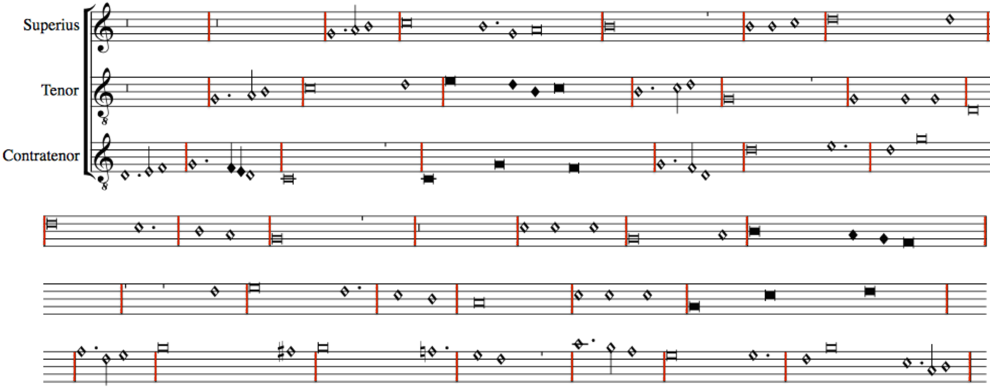
Without using the Scoring-up Tool
Notes:
Say the ”DURATION stuff” HERE TOO
VEROVIO INTERPRETS ALL NOTES AS HAVING THE DURATIONAL VALUE GIVEN BY THE MENSURATION
UNLESS, THE MODIFICATION ON THE DURATION OF A NOTE IS ENCODED WITHIN THE NOTE
WHICH IS WHAT THE SCORING-UP TOOL DOES.
WE NEED TO ENCODE THE EFFECT OF THAT MODIFICATION
THIS IS, WE NEED TO ENCODE THE MODIFIED DURATION.

Slide 17
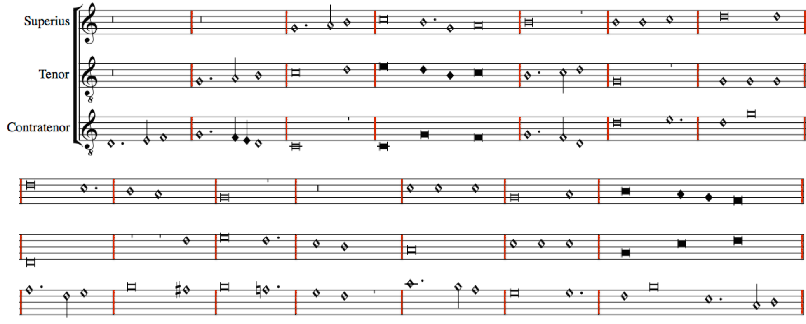
With the Scoring-up Tool
Notes:
Show here:
The Imperfections
The Alterations
The coloration
The distinct dots

Slide 18
Conclusions
The scoring-up tool presents the piece in score format
Facilitates visualizing the vertical sonorities and studying the relation between the voices of a piece, which was difficult given the separate-parts layout of the original sources
Preserves the original note values
Notes:
[After 3] Making it faithful to the source, while providing additional information (regarding the vertical sonorities)

Slide 19
Soprano
Mensural MEI file
________
________
Scoring-up
Tool
OMR
Soprano part
Mensural
MEI file
________
________
________
________
________
Contra
Mensural MEI file
________
________
OMR
Contra part
Tenor
Mensural MEI file
________
________
SCORE
OMR
Tenor part
Notes:
Meant to be the second part of a larger workflow
In which the first part consist on performing Optical Music Recognition on a set of mensural pieces,
From which we would obtain the Mensural MEI files encoding each voice. These files capture only the information present in the sources (this is, pitch and note symbols)
These are the input files of the Scoring-up, which finds the durational values of all the notes within these files based on contextual and non-contextual cues and returns the Mensural MEI file encoding the score.

Slide 20
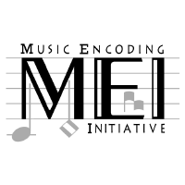
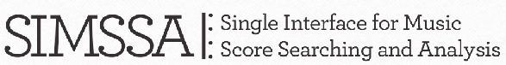

Thank you!

